Slide 1
Tutorial: Must-Know Basics for Machine Learning
Dr. Sourasekhar Banerjee (Ph.D.)

Slide 2
Objective and Learning Outcome
Objective
Installation of the Python and Jupyter notebook framework
Introduce key concepts, terminologies, and tools to prepare participants for advanced topics like regression, feature engineering, classification, and artificial neural networks
Learning Outcome
Participants will understand the basic workflow of machine learning.
Key tools in the Python ecosystem, and foundational concepts to build upon in subsequent lectures.

Slide 3

Jupyter notebook Installation
Click here to find the Jupyter notebook installation tutorial
Install VS-Code for better experience. Click here
Google Colab is an alternative to all those local setup

Slide 4
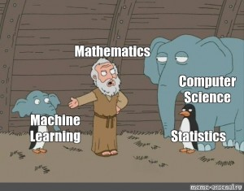
Introduction to Machine Learning
What is Machine Learning (ML) ?
Branch of artificial intelligence (AI)
Enables computers to learn from data and make decisions or predictions.
ML algorithms improve their performance by identifying patterns in data.

Slide 5

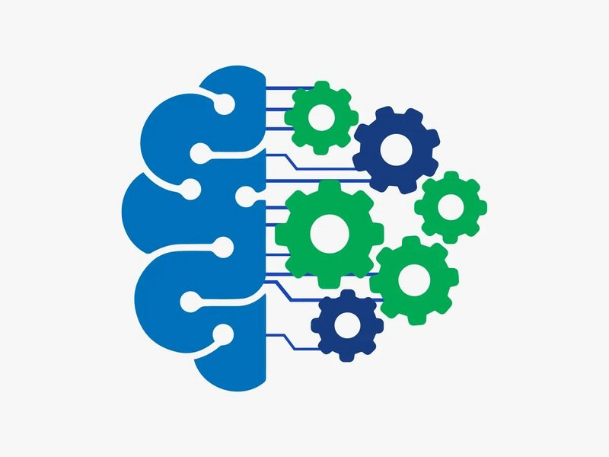

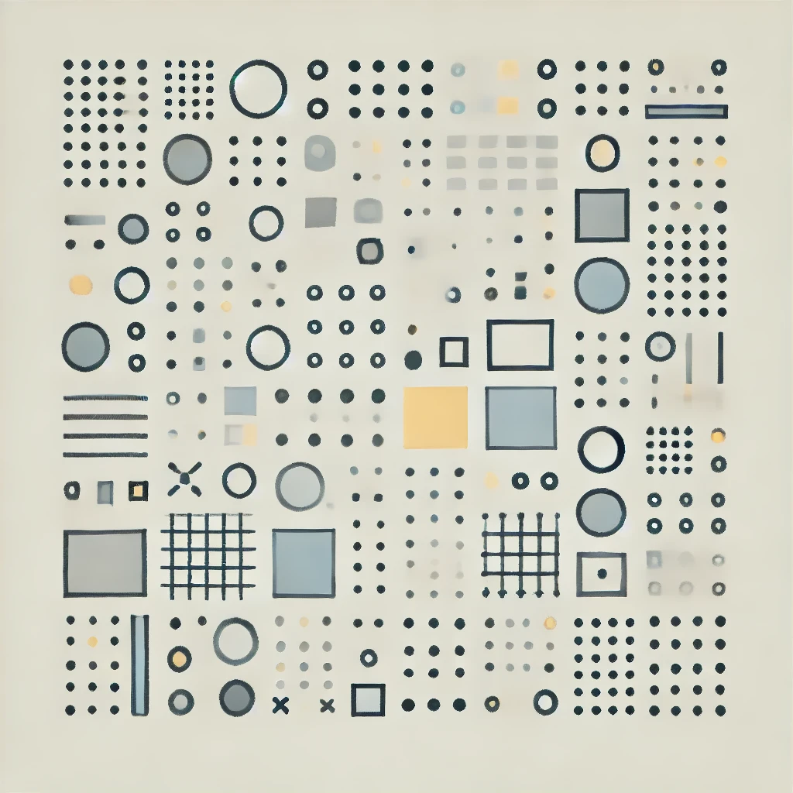
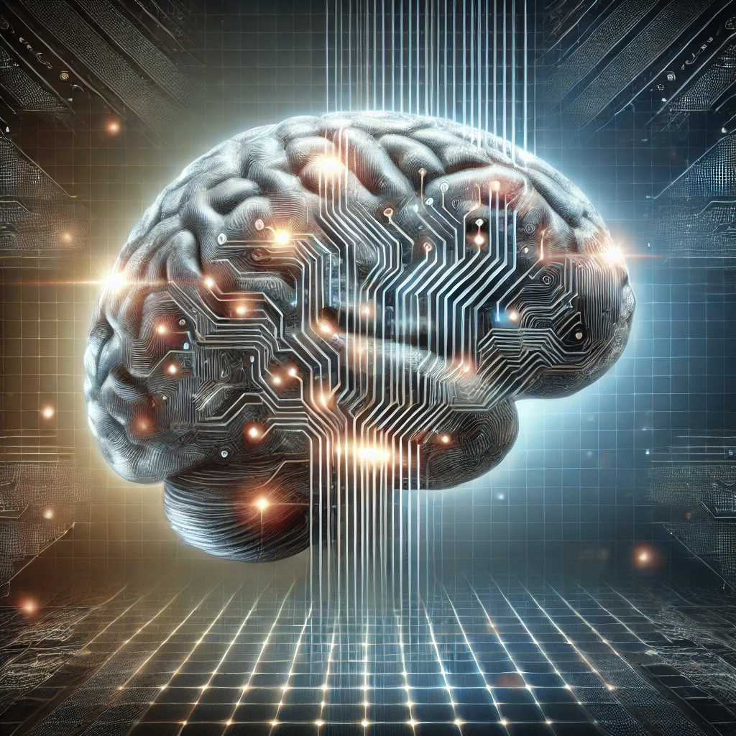

Key Components of ML
Test data
Model
Prediction
Raw Data
Features
Training/Learning
Feature Engineering
Evaluation

Slide 6
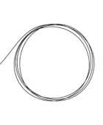
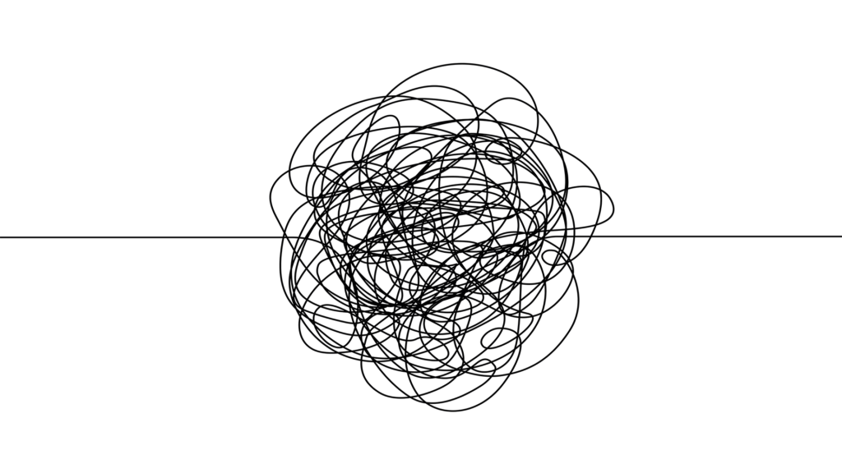
Data
Dirty Data
Incomplete – Missing/null values
Inaccurate – Incorrect values or calculations
Inconsistent – Different unit of measurements
Duplicate – same data reordered more than once
Outdated - No longer relevant
Incorrectly formatted – invalid characters
Cleaning
Feature Engineering

Slide 7
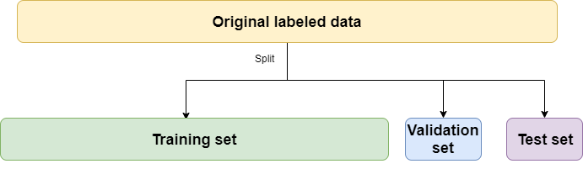
Dataset

Slide 8
Metrics
Performance
Accuracy : Good for balanced datasets
F1-Score : Best for imbalanced datasets
R2 : Used in regression to evaluate model fit
Loss function
Mean Square Loss (MSE) and Root Mean-Square Loss (RMSE) : Suitable for regression tasks
Cross-entropy (CE): Suitable for classification tasks

Slide 9
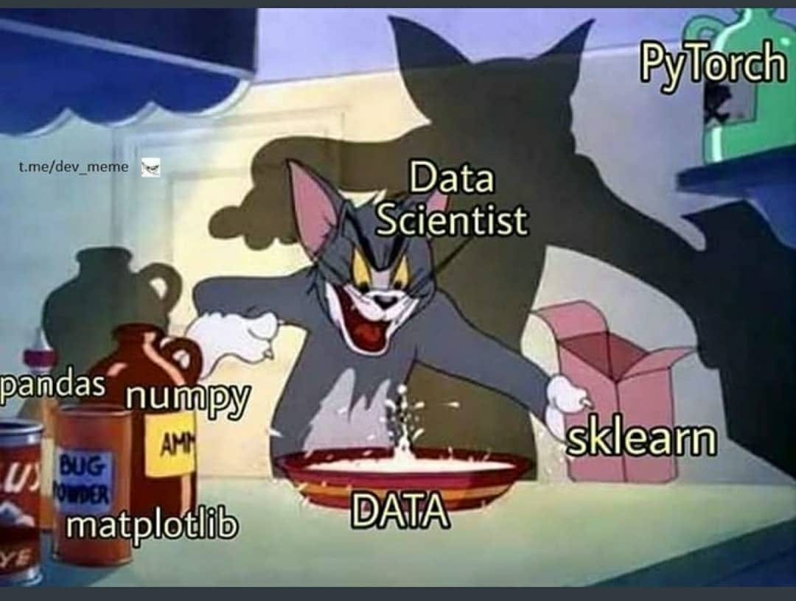
Python Ecosystem for Machine Learning
Notes:
Must-Know Libraries
Numpy: Arrays and Numerical operations
Pandas: Data manipulation and analysis
Matplotlib/Seaborn: Data visualization
Scikit-learn: Preprocessing, algorithm, and evaluation
Pytorch: Deep learning

Slide 10
Hands-on
Numpy tutorial
Pandas tutorial

Slide 11
Thank You!

